Slide 1


Deploying AI4SG Applications
From Optimization to Sustainable Change
Amulya Yadav
Associate Professor, College of IST, Penn State

Slide 2
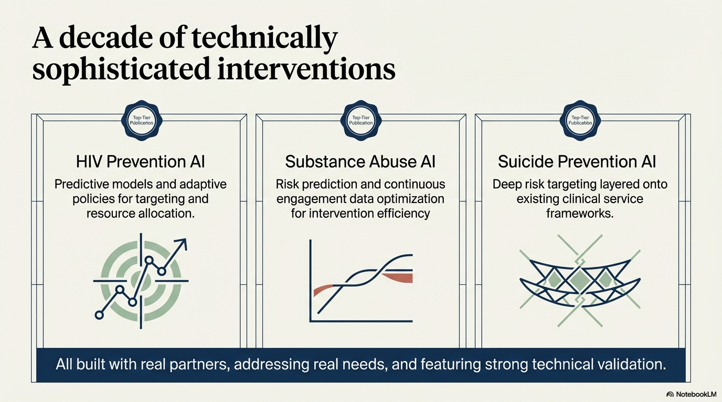

Slide 3
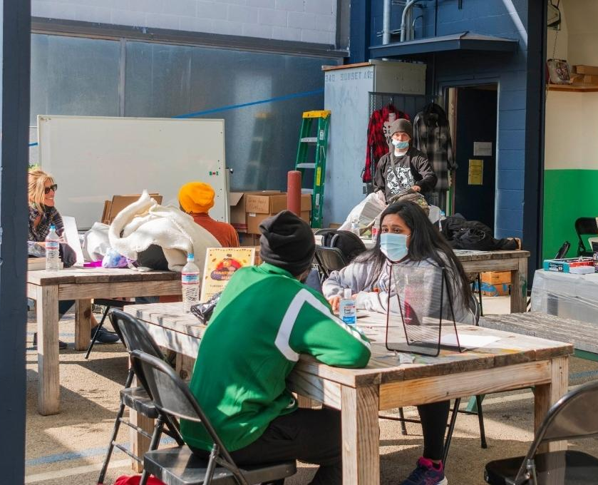
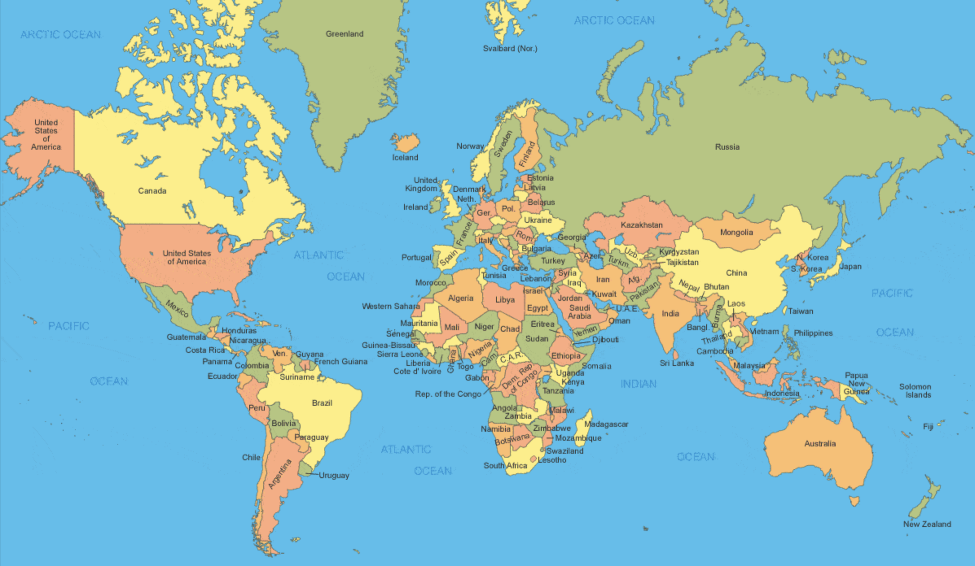
Case Study 1 AI for HIV Prevention

Slide 4



Case Study 1: Description
NGO Collaborator:
What do they do? Run Peer Led Popular Opinion Leader (POL) interventions to spread awareness about STDs and to change behaviors
What did they need help with? How to choose peer leaders for this intervention
How did we help? HEALER and CHANGE: Two AI agents that could identify key peer leaders who would serve as good “influencers” in the network (JAIDS, AAAI 21, IJCAI 18, AAMAS 18a, AAMAS 18b, AAMAS 17a, AAMAS 17b, IJCAI 17, AI Magazine, AAMAS 16, IAAI 15)

Slide 5
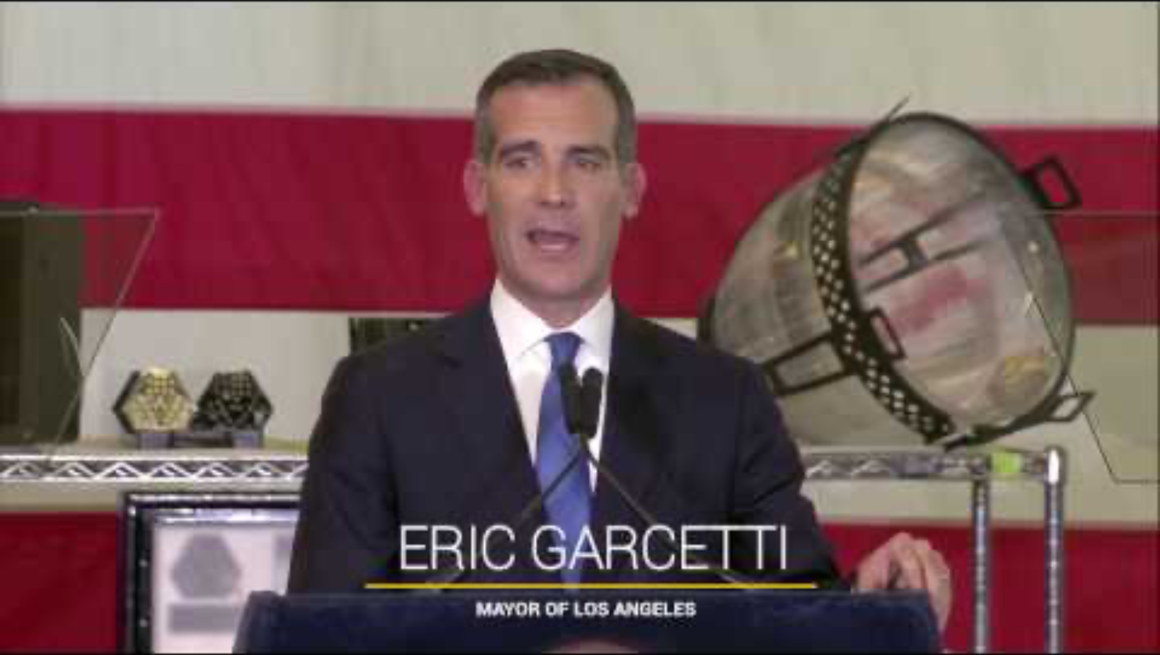
Case Study 1: High-Level Explanation

Slide 6
Case Study 1: Key Results

Slide 7
Case Study 1: Key Results

Slide 8
Case Study 1: Key Results

Slide 9
Case Study 1: Key Results

Slide 10
Case Study 1: Key Results

Slide 11

Case Study 2 AI for Substance Abuse

Slide 12

Case Study 2: Description
NGO Collaborator:
What do they do? Assigning homeless youth to preventive programs against potential opioid abuse
Limited number of program slots, lots of homeless youth who could potentially develop opioid abuse disorders in the coming future
What did they need help with? How to make the best use of the limited preventive program slots that they had?

Slide 13
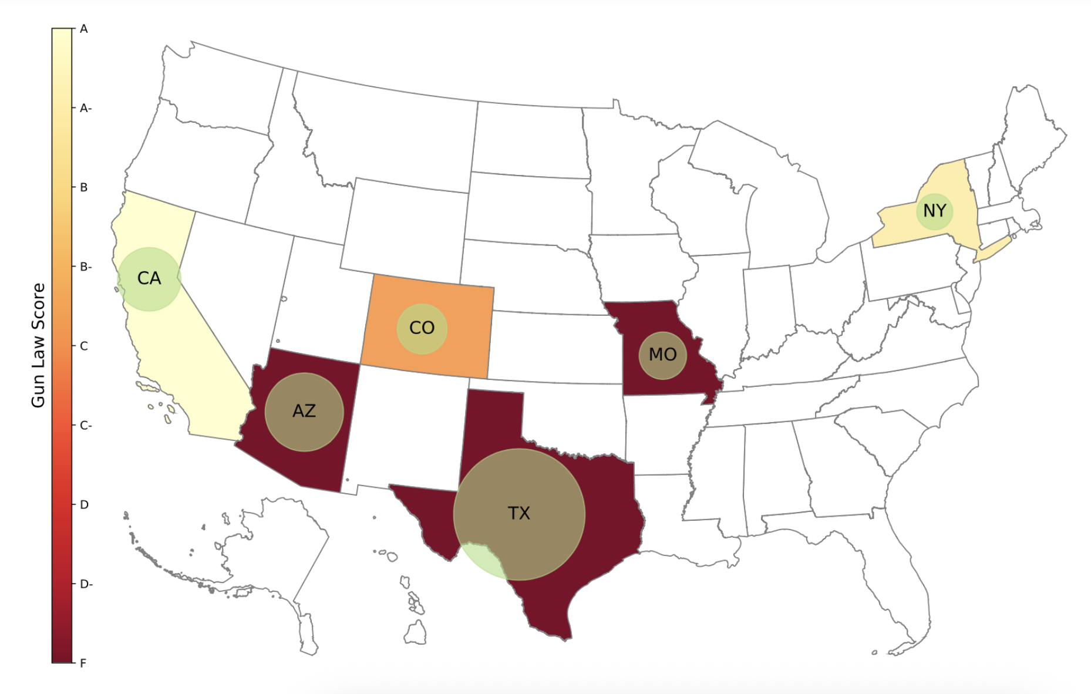
Case Study 2: Description
NGO Collaborator:
How did we help?
Stage 1: Predict the likelihood of an individual youth developing opioid use disorder in the future
Using survey data (KDD 2020)

Slide 14
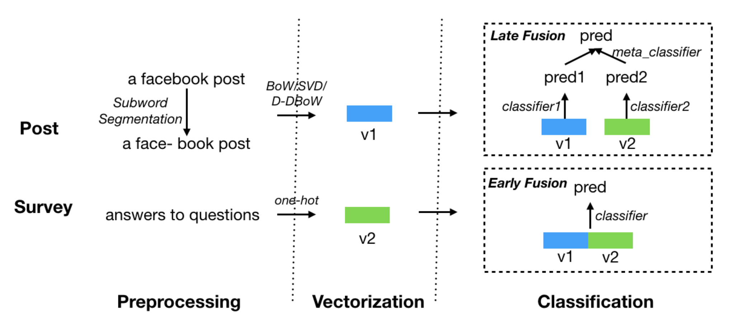
Case Study 2: Description
NGO Collaborator:
How did we help?
Stage 1: Predict the likelihood of an individual youth developing opioid use disorder in the future
Using survey data (KDD 2020)
Using Facebook posts (AAAI 2021)
“So cute!! I want one!! <3.”
“Smoke weed every day”
Sample Quote from
Non-Substance User
Sample Quote from
Substance User

Slide 15
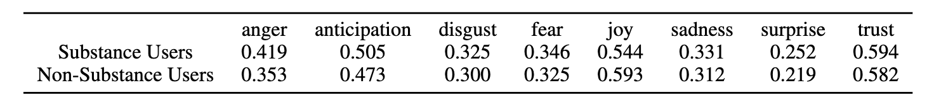
Case Study 2: Description
NGO Collaborator:
How did we help?
Stage 1: Predict the likelihood of an individual youth developing opioid use disorder in the future
Using survey data (KDD 2020)
Using Facebook posts (AAAI 2021)
“So cute!! I want one!! <3.”
“Smoke weed every day”
Sample Quote from
Non-Substance User
Sample Quote from
Substance User

Slide 16
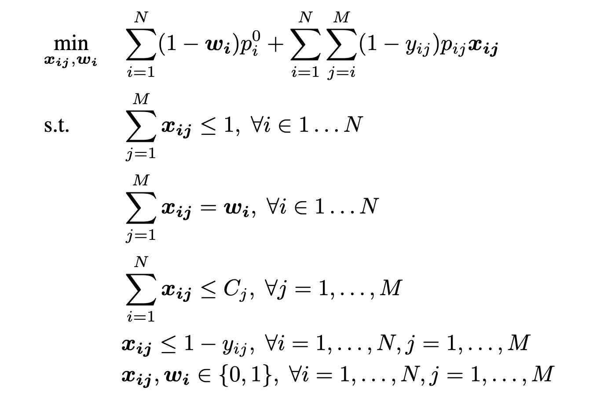
Case Study 2: Description
NGO Collaborator:
How did we help?
Stage 2: Use Stage 1 predictions to assign youth to program slots to maximize efficiency
Predict-then-Optimize pipeline (IJCAI 2020)

Slide 17

Case Study 3 AI for Suicide Prevention

Slide 18

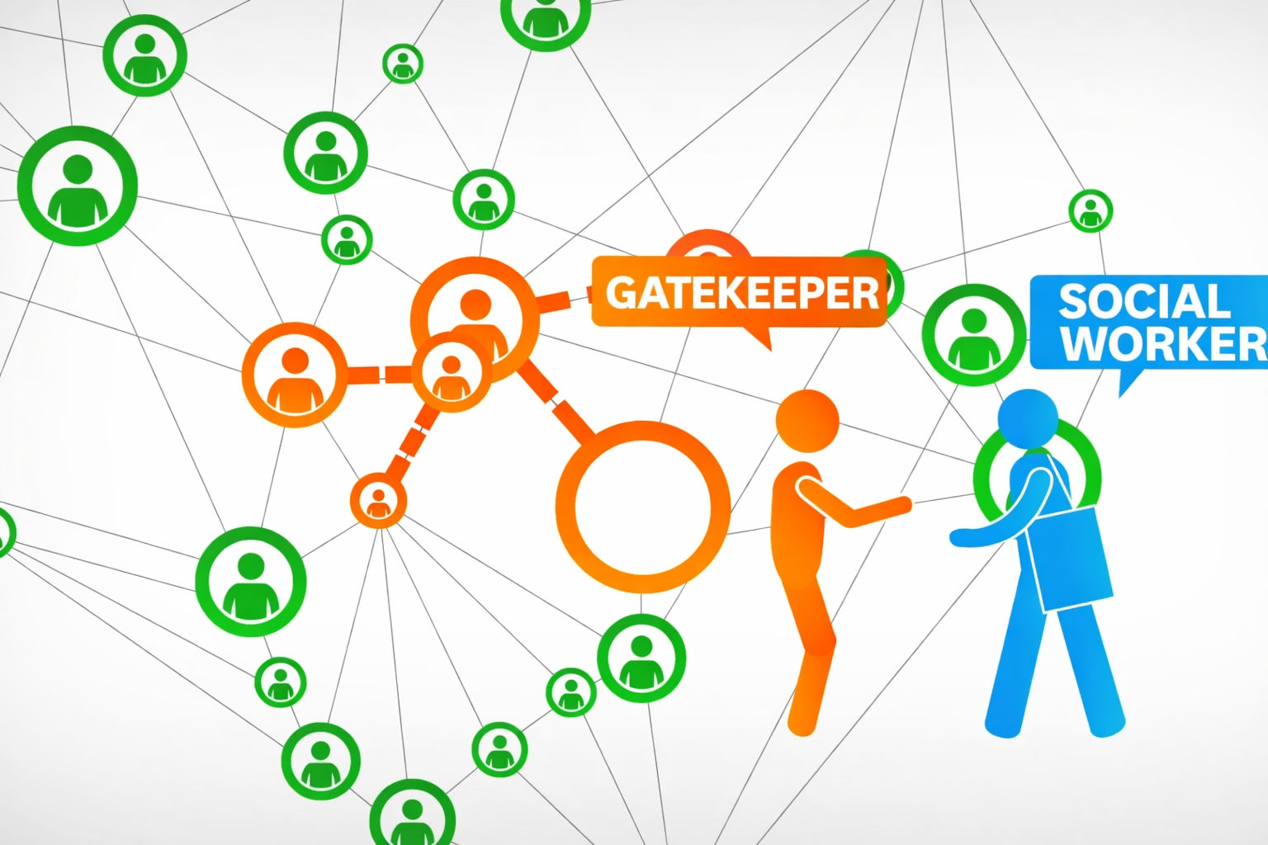
Case Study 3: Description
NGO Collaborator:
What do they do? Gatekeeper training interventions among homeless
Gatekeepers tasked with looking out for suicidal tendencies among their peers
Goal: To maximize the number of people who are cared for by a gatekeeper

Slide 19
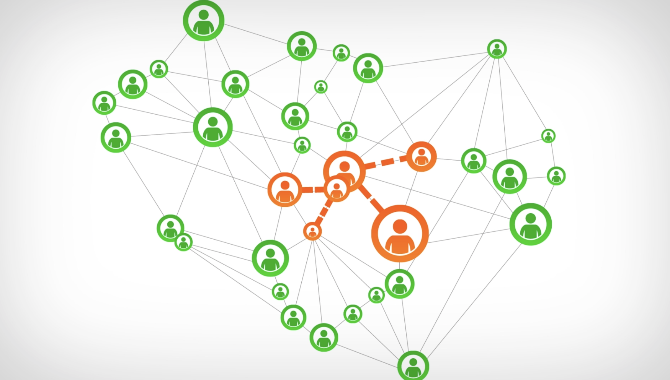
Case Study 3: Description
NGO Collaborator:
What did they need help with?
Assuming partial information about a social network of youth, which people should be selected as ideal
gatekeepers?

Slide 20
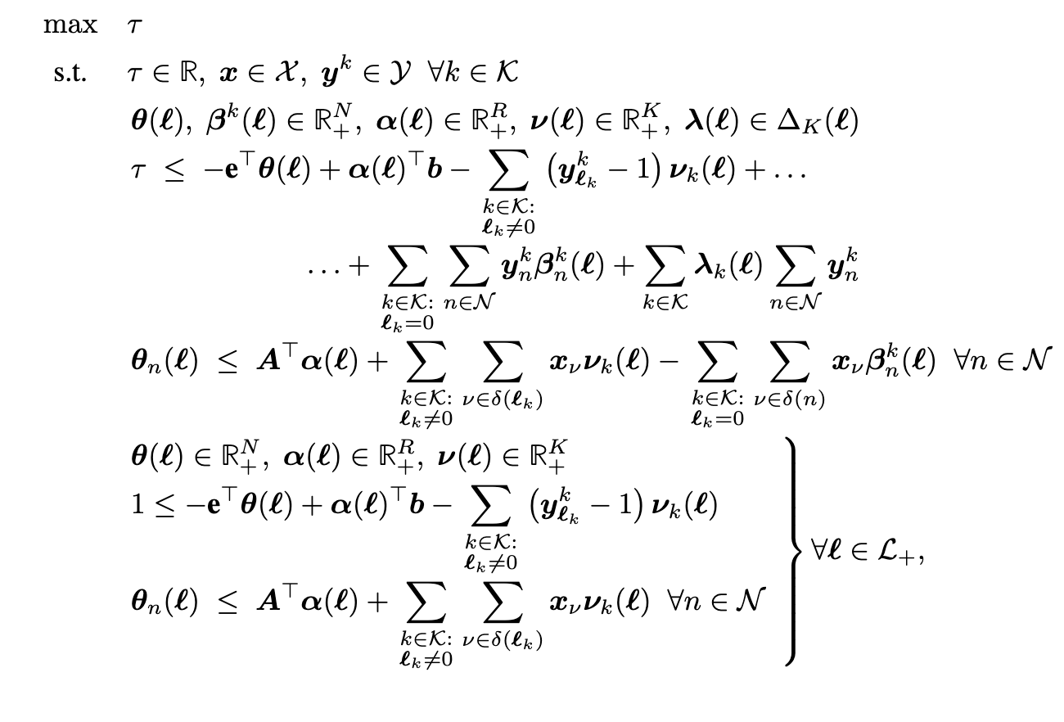
Case Study 3: Description
NGO Collaborator:
How did we help? Mixed Integer Bilinear program to select the optimal set of gatekeepers that could maximize network coverage (NeurIPS 19)
Some youth may say no when we enroll them to be gatekeepers
Want gatekeeper selection to be robust

Slide 21

Case Study 4 AI for Pregnant Women & New Mothers in Rural Kenya

Slide 22

Case Study 4: Description
NGO Collaborator:
What do they do? PROMPTS – A Tele Triage Tool to Answer Q&A for Pregnant Women
What did they need help with? All Q&A needed to be answered manually. Shortage of helpdesk operators to answer all incoming Q&A
How did we help? TRIM-AI: An AI system that reads incoming SMS messages and determines risk level, high-risk SMS should be read first

Slide 23
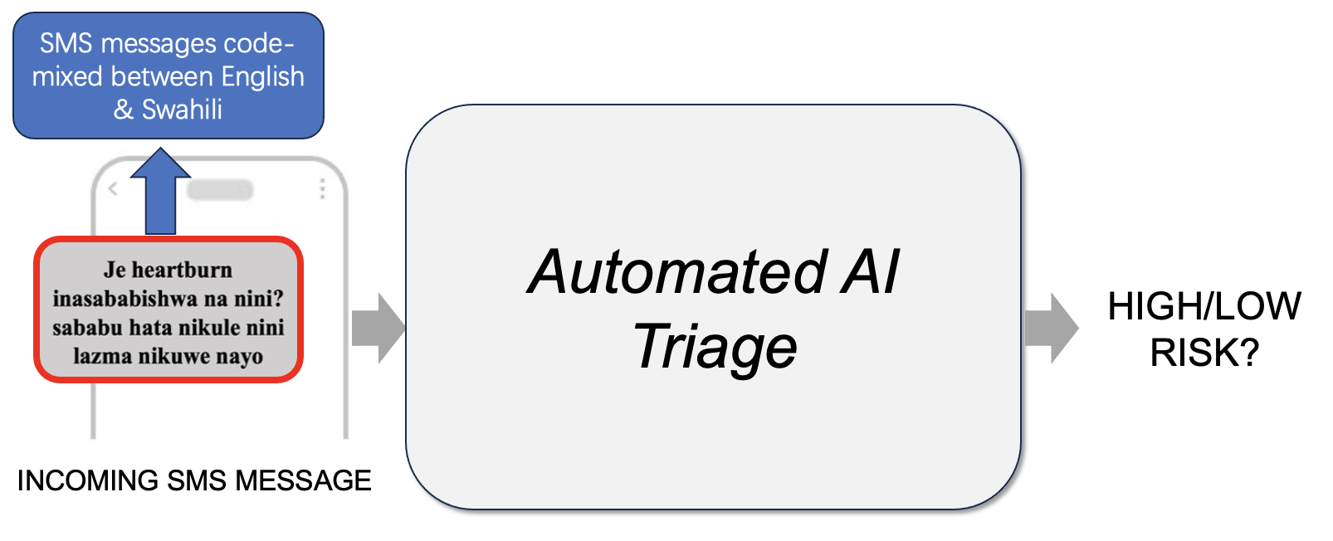
Case Study 4: High-Level Explanation

Slide 24
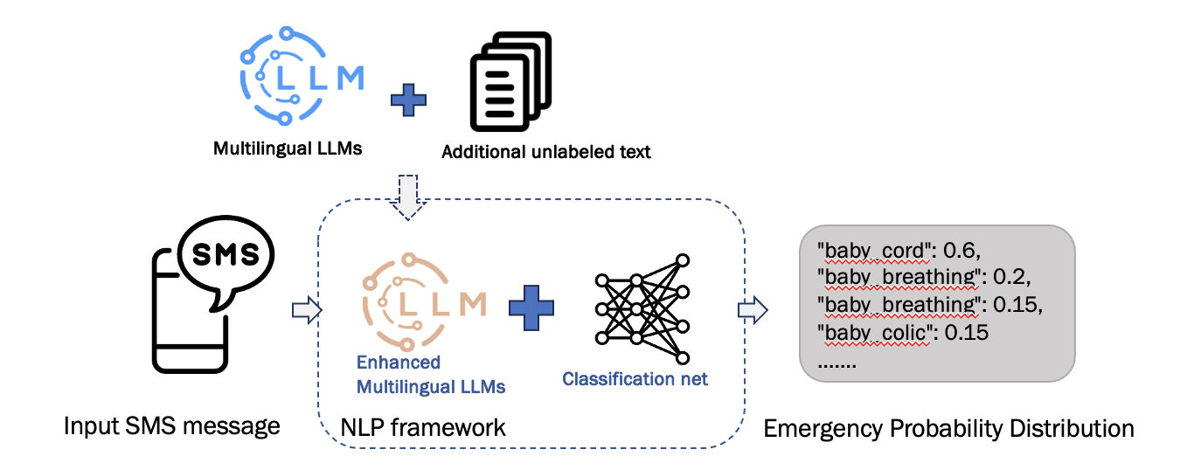
Case Study 4: High-Level Explanation

Slide 25
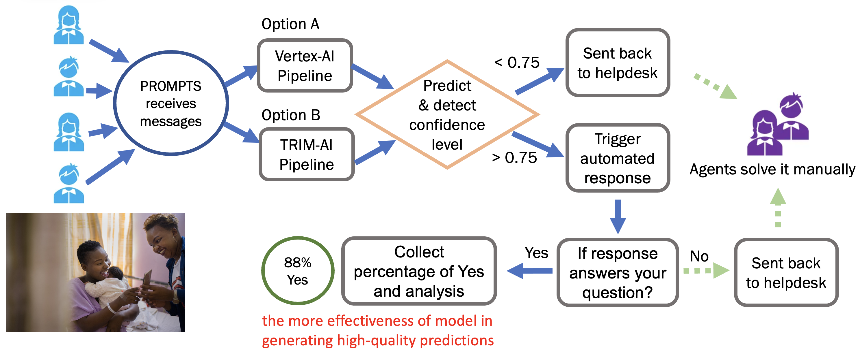
Case Study 4: Key Results

Slide 26
Case Study 4: Key Results
17% improvement in predictive accuracy
12% reduction in helpdesk workload
90% reduction in cost

Slide 27
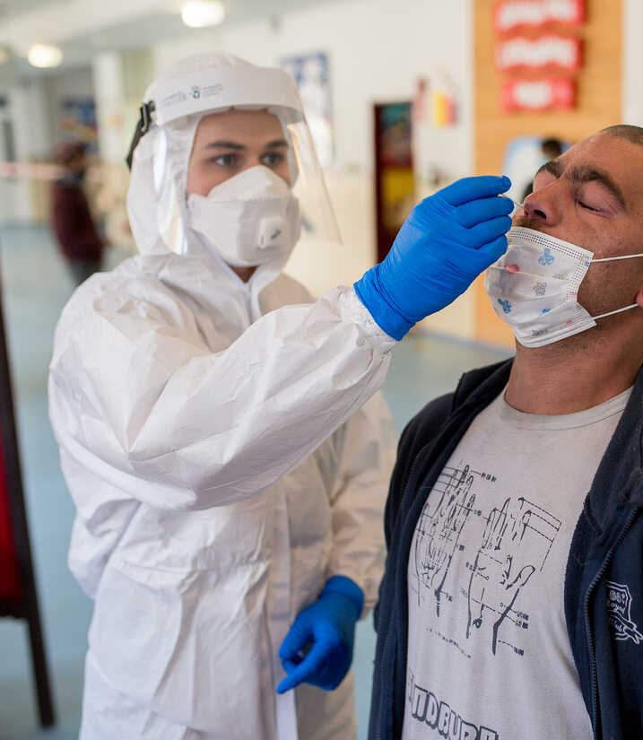
Case Study 5 POMDPs for Testing Policy Design for COVID-19

Slide 28

Case Study 5: Description
NGO Collaborator:
What was the problem? COVID-19 was in full flow
Should Penn State open in-person for the Fall 2020 semester?
If so, how many COVID tests need to be procured, and how should they be allocated?
They were leaning towards a static solution:
1200 daily tests for in-hospital testing
880 daily tests (1% of student population) for random asymptomatic testing
What did they need help with? Can AI be used to develop a better testing policy
How did we help? DOCTOR: A POMDP solver that generated an optimal adaptive testing policy for determining how should next week’s tests be allocated (dependent on history)

Slide 29
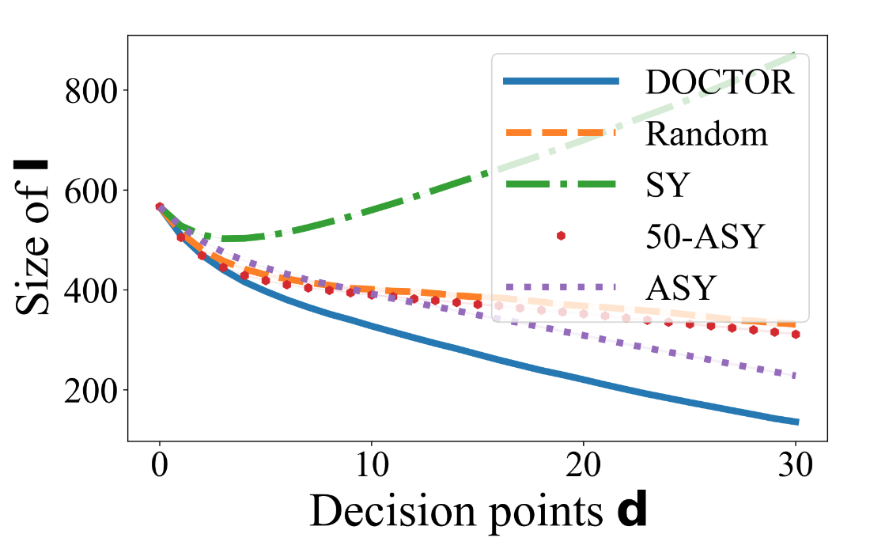
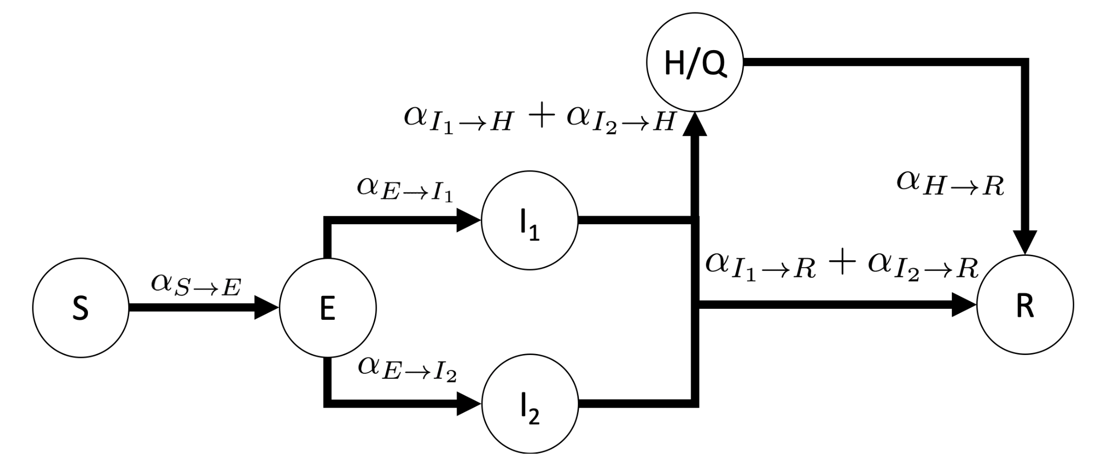
Case Study 5: Key Results
Flow Dynamics of SEIR Based Transition Model of DOCTOR’s POMDP
(AAMAS 2021)
DOCTOR resulted in 30% fewer infections as compared to Penn State’s strategy

Slide 30
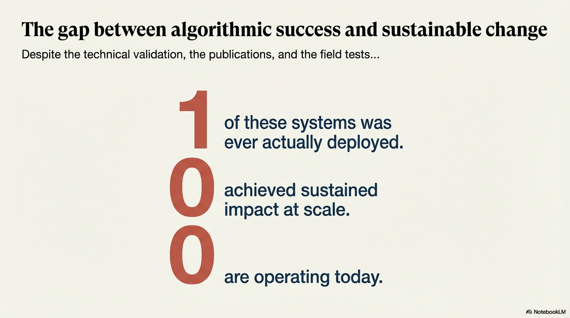

Notes:
Over the past decade, our lab has built AI systems for HIV prevention, for substance abuse intervention, and for suicide prevention.
These systems were technically sophisticated.
They were evaluated in the field.
They were published at top conferences.
They were celebrated as examples of AI for Social Good.
And yet —
Only two of them was ever actually deployed.
And one of them is operating today at scale.

Slide 31
Deployment in AI4SG (for HIV Prevention)
What do successful deployments look like in AI for Social Good?
What have they looked like in HIV prevention projects?
Algorithm development
Several pilot studies with homeless youth
One large multi-year clinical trial with homeless youth (ended in 2021)
No one is using it at the moment ☹

Slide 32
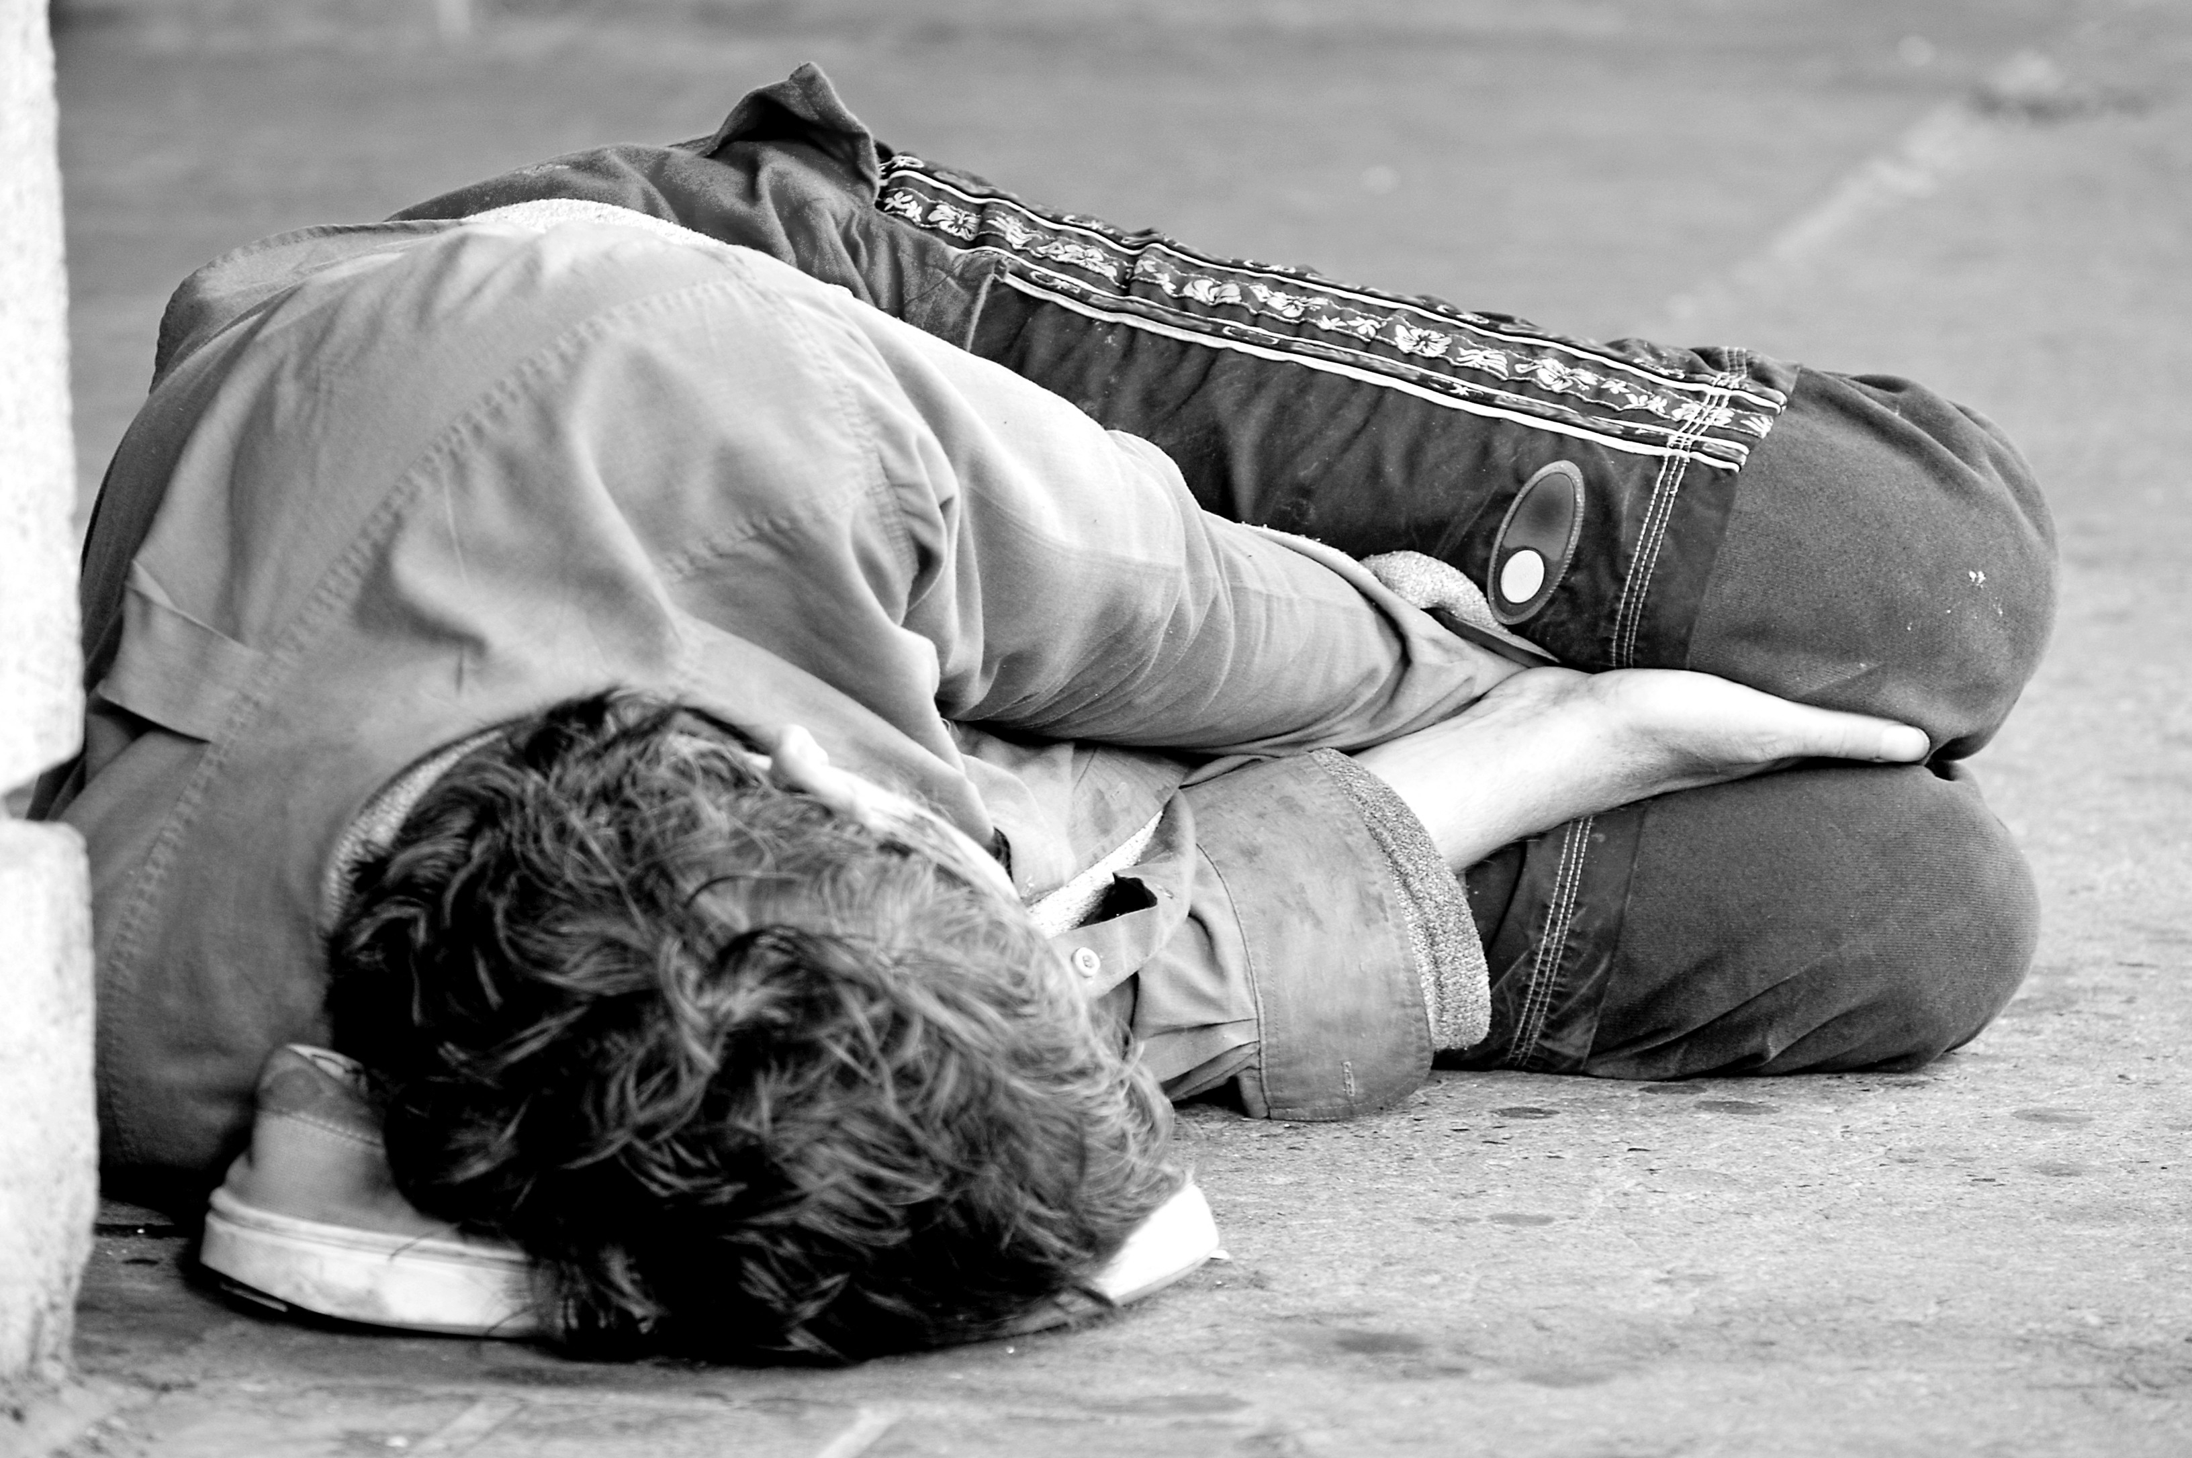
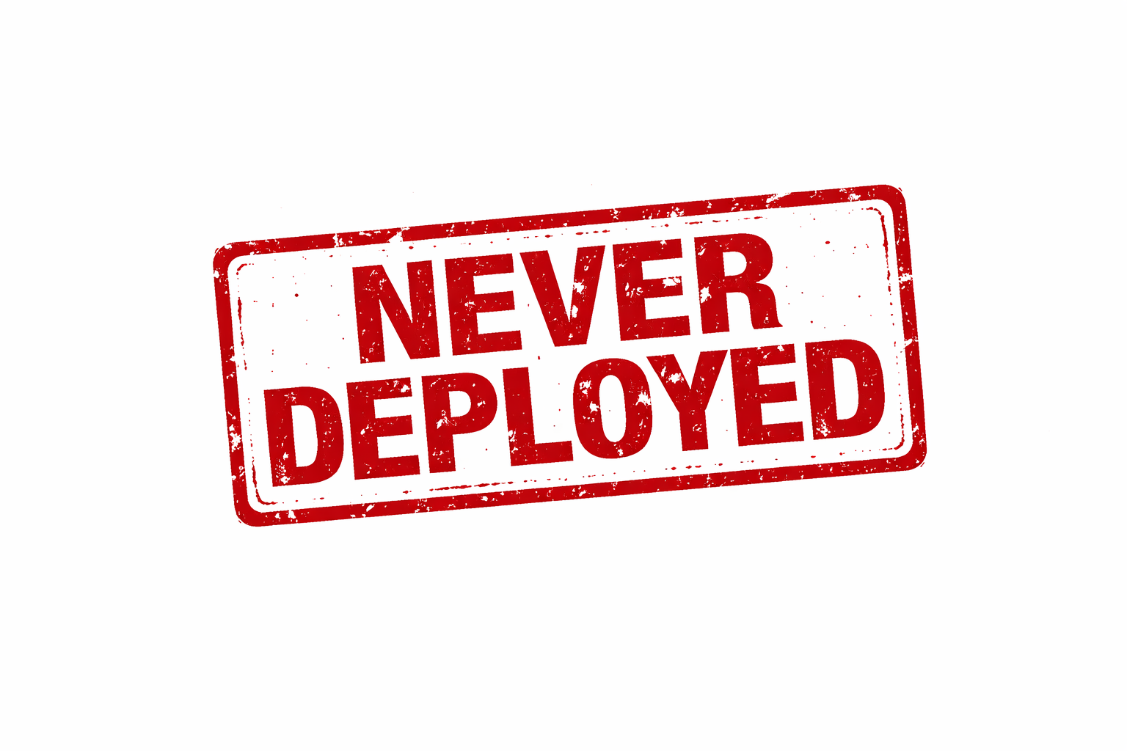
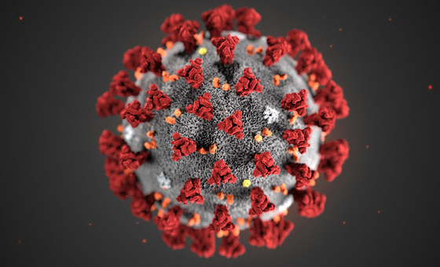
Deployment in AI4SG
AI for Substance Abuse
AI for Suicide Prevention
AI for POMDP Testing
Cause of Failure
No Buy-in from NGO Leadership
Cause of Failure
Dynamic & Divergent Priorities
Cause of Failure
Territorial Disputes

Slide 33


Deployment in AI4SG (in other domains)
AI for Substance Abuse
AI for Suicide Prevention
AI for POMDP Testing
Cause of Failure
No Buy-in from NGO Leadership
Cause of Failure
Dynamic & Divergent Priorities
Cause of Failure
Territorial Disputes
AI for Prevention of Online Child Sexual Abuse
Cause of Failure
Improper Perceptions of AI

Slide 34

Deployment in AI4SG (in other domains)
AI for Substance Abuse
AI for Suicide Prevention
AI for POMDP Testing
Cause of Failure
No Buy-in from NGO Leadership
Cause of Failure
Dynamic & Divergent Priorities
Cause of Failure
Territorial Disputes
AI for Prevention of Online Child Sexual Abuse
AI for Mental Health Triage
Cause of Failure
Improper Perceptions of AI
Cause of Failure
Red Tape in Getting Data Agreements

Slide 35
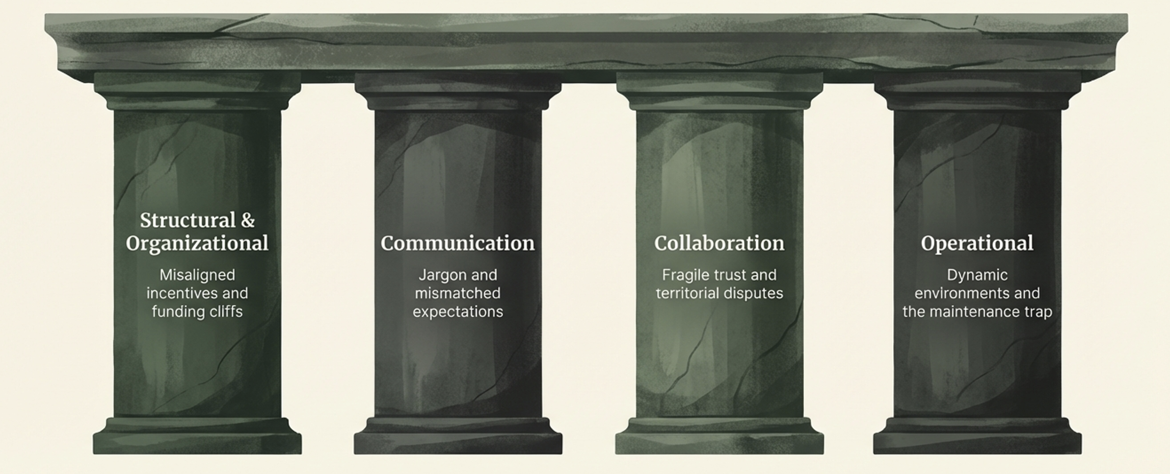
Different Failure Modes - AI4SG Deployment
Majumdar et al., The Hardness of Achieving Impact in AI for Social Impact Research (FaCCT 26 Submission)

Slide 36
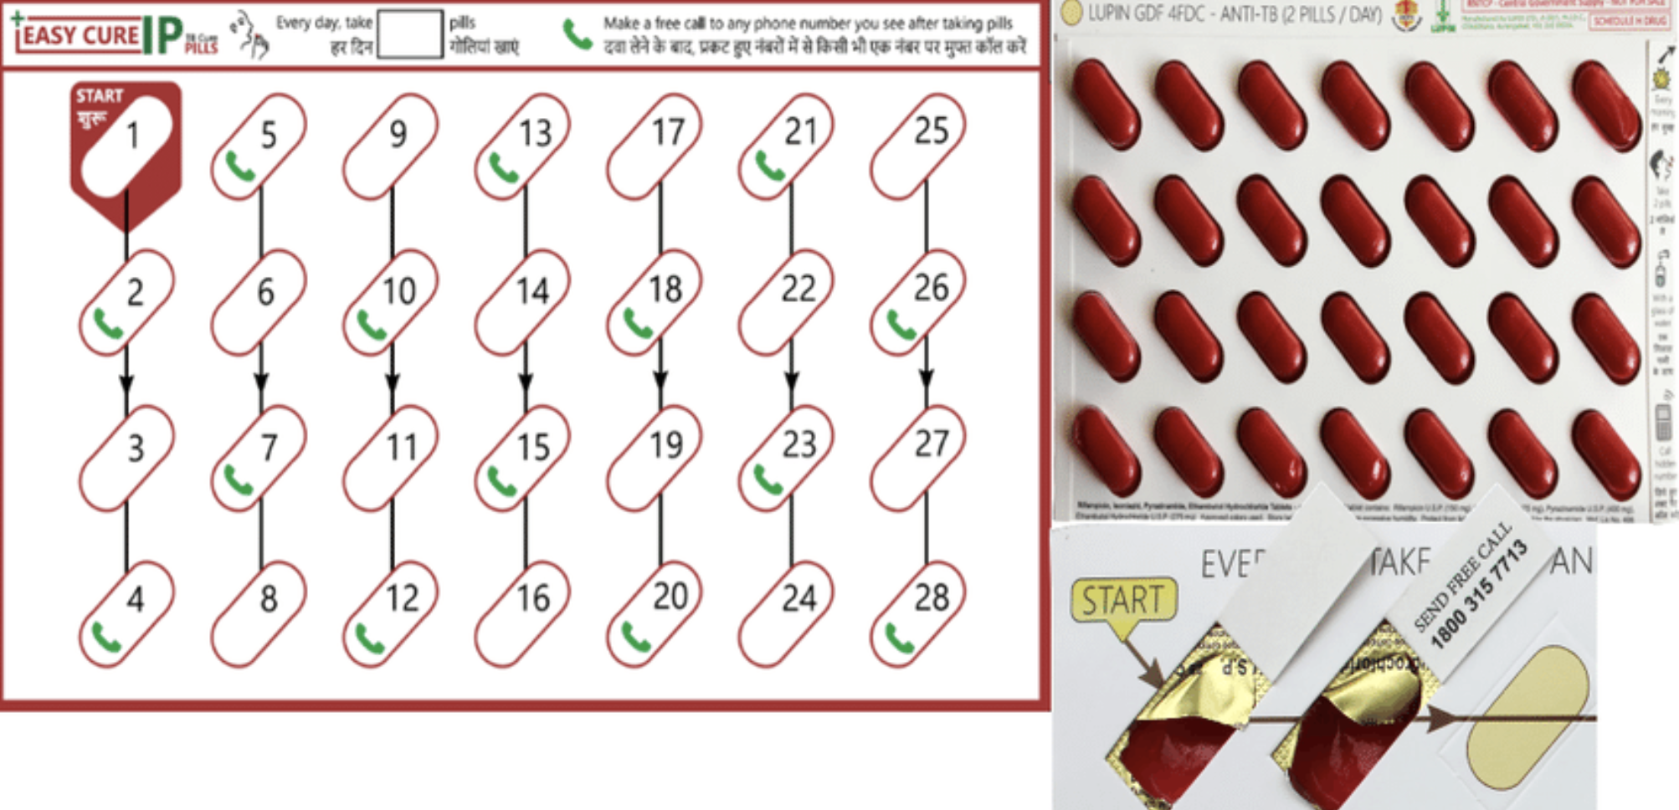
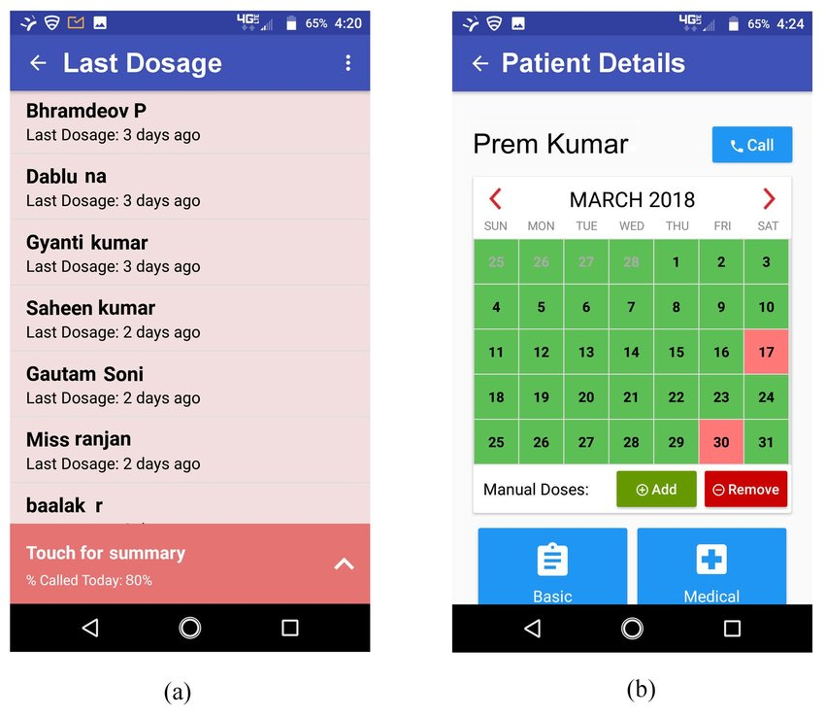
A Contrastive Case: 99DOTS

Slide 37
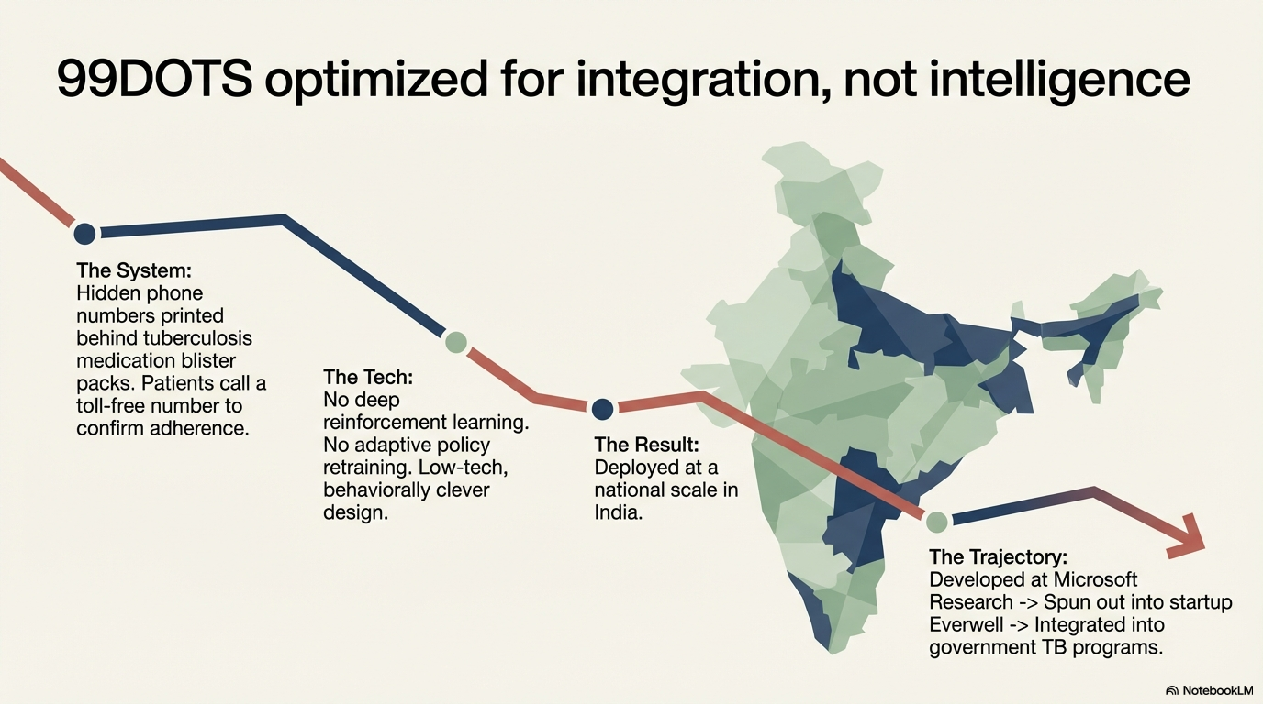

Slide 38
What was different about 99DOTS?

Slide 39
Why did 99DOTS live beyond the research stage? – Technical Simplicity
Was it because of its technical simplicity?
Easier to explain to stakeholders, no sense of ”black-box AI magic”
Conversely, were AI4SG projects doomed for “failure” because we optimize for acceptance into AI conferences?
Need fancy math, elegant theorems to get into these conferences

Slide 40
Why did 99DOTS live beyond the research stage? – Technical Simplicity
Hard to explain what this is doing to govt stakeholders
Was it because of its technical simplicity?
Easier to explain to stakeholders, no sense of ”black-box AI magic”
Conversely, were AI4SG projects doomed for “failure” because we optimize for acceptance into AI conferences?
Need fancy math, elegant theorems to get into these conferences
Sometimes, “complex” solutions may be the only way to solve the stated problem

Slide 41
Why did 99DOTS live beyond the research stage? – Institutional Support
Was it because 99DOTS was developed within the Microsoft ecosystem?
Easy access to well-trained software development teams
Makes it easier to develop POCs
Conversely, who does this work in academic AI4SG projects?
PhD students, who are not being trained for software dev
Maybe undergrad students, but steep learning curve

Slide 42
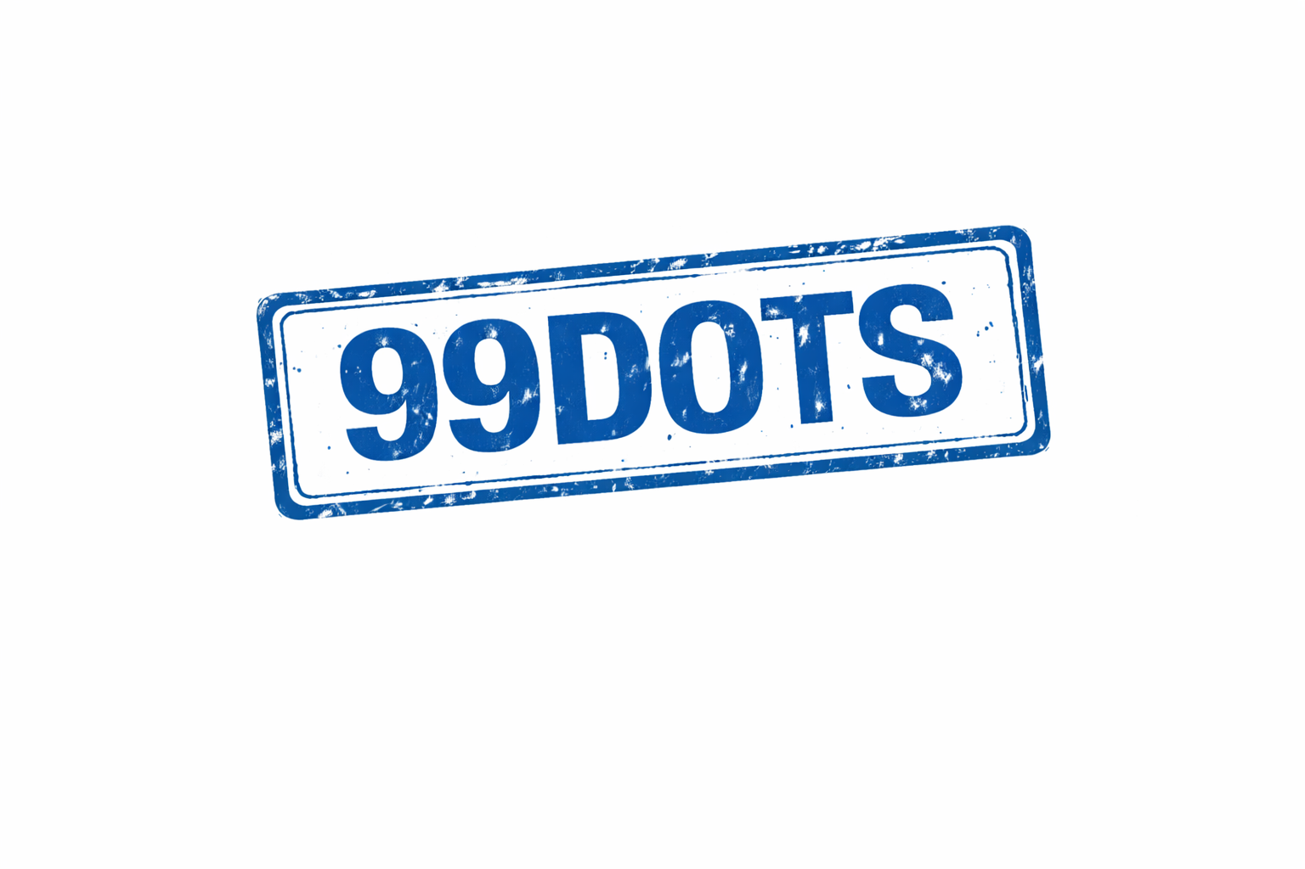

Why did 99DOTS live beyond the research stage? – Local Capacity
Was it because there was local capacity available which could “own” the project sustainably?
No Funding for
Tech Initiatives
Dedicated Tech Teams

Slide 43
Why did 99DOTS live beyond the research stage? – Minimal Effort Required to Integrate
Was it because the data requirements were minimal?
Compared to AI4SG projects which often do not start until data is received from the non-profit side
AI for Mental Health Triage
Cause of Failure
Red Tape in Getting Data Agreements

Slide 44
What can we do about these issues?
Do we even want to?
Is it even our job as academics to achieve sustainable change?
Should we be more selective in how we decide problems to work on?
Simple Problems? – At odds with current academic structures
Simple Solutions? - At odds with current academic structures
Partner with well-funded non-profits who have lots of funding? – Seems exclusionary

Slide 45
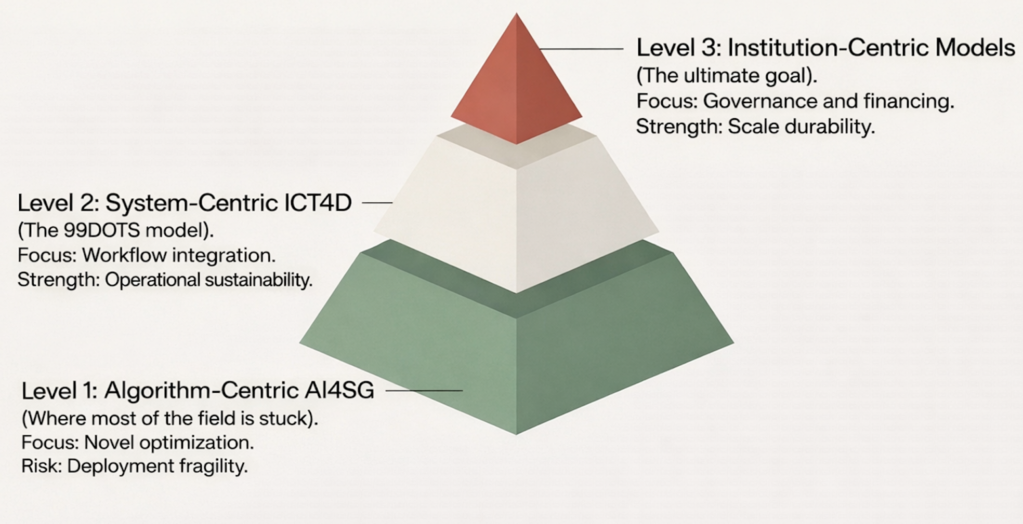
A Maturity Model for AI4SG Research

Slide 46
A Maturity Model for AI4SG Research
Academic incentive structures force academics to focus on Level 1 of this pyramid
Level 3 applications emerge as a “happy” coincidence

